Slide 1
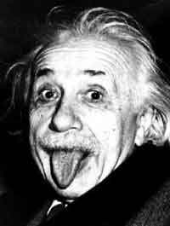
Albert Einstein
Reported by Brian Worrall

Slide 2
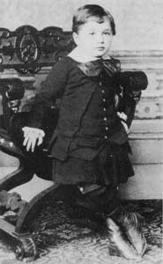
Albert Einstein
Born March 14th, 1879 in Ulm, Germany
Father (Hermann Einstein) was a scientist and a salesman
Mother (Pauline Koch) worked in the family’s electrical machine shop
Was given a compass at age 5, giving him his scientific curiousity

Slide 3
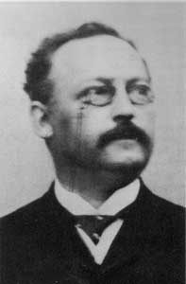
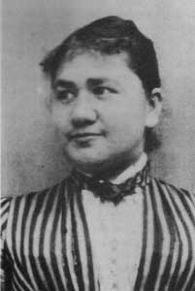
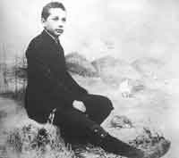
Albert Einstein
Lived in Munich until the age of 15
His mother forced him to learn the violin and continued to play it into his later years
Excelled at Logic and Mathematics at an early age
Taught himself Euclidean Geometry at 12

Slide 4
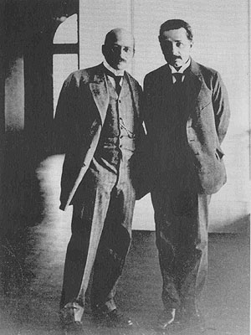
Albert Einstein
In 1894, a 15 year old Albert dropped out of his Munich high school
That year he wrote his first scientific work called “The Investigation of the State of Aether in Magnetic Fields”
Finished off his diploma in Aarau, Switzerland in September 1896
Entered the Swiss Federal Institute of Technology in Zürich shortly after

Slide 5
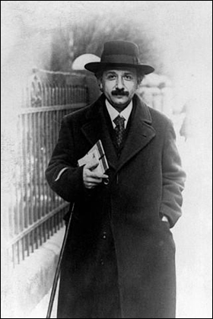
Albert Einstein
Albert would frequently cut class and raise to question his professors’ authority
Graduated in 1900 by studying a colleague’s notes
Gained degree in Physics and Mathematics

Slide 6
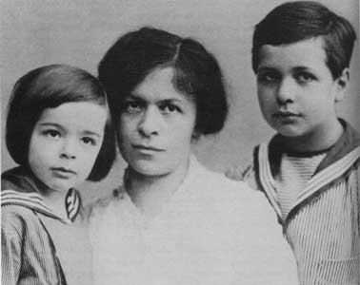
Albert Einstein
Met his first wife Milvena Maric at the University of Zurich
Their first child Lieserl (born in 1902) was given up for adoption and forgotten
Milvena and Albert marry in 1903
Hans Albert Einstein was born in 1904 and ended up being a professor of hydraulic engineering at the University of California
Eduard Einstein was born in 1910 and ended up being institutionalized for schizophrenia and died in asylum

Slide 7
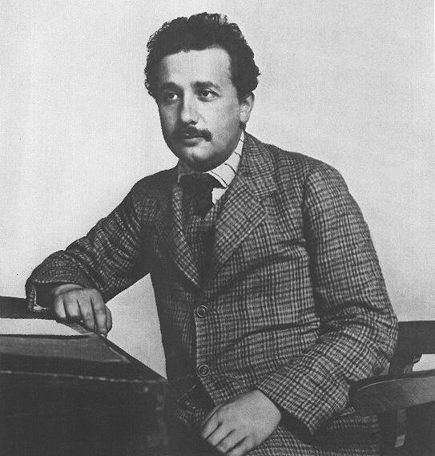
Albert Einstein
Due to his blustering in his early years, Albert was not particularly hireable
In 1902, Albert finally got a job in the Swiss Patent office where he examined and sometimes improved on designs that required some knowledge of Physics
In 1905, Albert obtained his doctorate with his thesis "A New Determination of Molecular Dimensions"

Slide 8
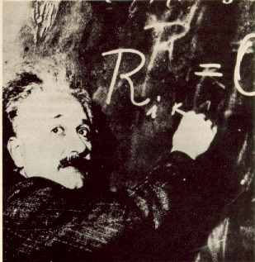
Albert Einstein
That same year, he published 4 articles
  "On a Heuristic Viewpoint Concerning the Production and Transformation of Light" –> Proposed photons and explained the Photoelectric Effect
  "On the Motion—Required by the Molecular Kinetic Theory of Heat—of Small Particles Suspended in a Stationary Liquid" -> Studied Brownian Motion and provided empirical evidence for the existence of atoms
  "On the Electrodynamics of Moving Bodies" -> Provided a theory that time, distance, mass and energy were consistent with electromagnetism and therein a relativity or relationship between objects
  "Does the Inertia of a Body Depend Upon Its Energy Content?" -> A Special Theory of Relativity E=root[(pc)^2+(mc^2)^2]

Slide 9
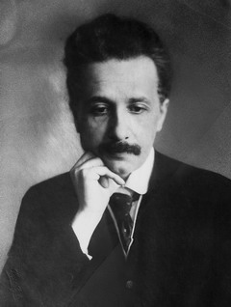
Albert Einstein
In 1911, he becomes a full-time professor at the German University in Prague
By 1912, Albert considered Time as the 4th dimension
In 1913, he begin to work with gravity in calculations
In 1914, Albert became director of the Kaiser Wilhelm Institute in Berlin and professor of theoretical physics at the University of Berlin
Finally, in 1915, he finished his general theory of relativity

Slide 10
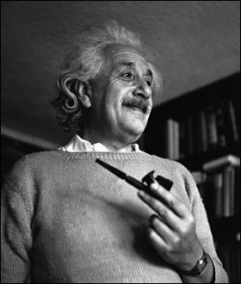
Albert Einstein
1917: the man collapsed with a nervous breakdown and stomach problems. His cousin tended him back to health
1919: Albert divorces Mileva in January and marries his cousin in June
In this year, he also wrote his first cosmology paper

Slide 11
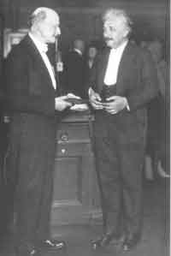
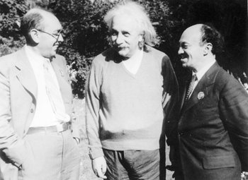
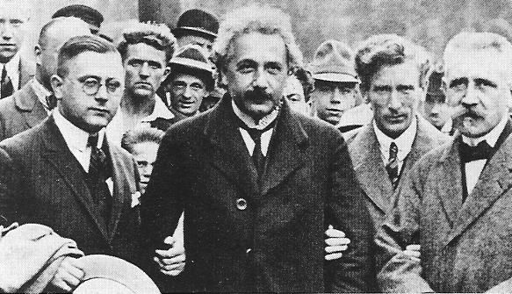
Albert Einstein
In 1919, a solar eclipse proved the General Theory of Relativity by tracking the curve of light from the sun
Received the Nobel Prize for Physics (1921) in 1922 for his work on the Photoelectric Effect (which proved mathematically that a photon displays both wave-like and particle-like properties) and not his General Theory of Relativity.

Slide 12
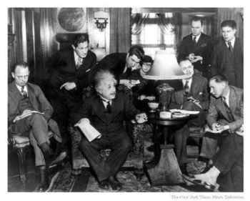
Albert Einstein
Quantum Physics replaced the old science, with Einstein on the lookout for a unified theory
1924: Einstein and Bose build the foundations of Quantum Statistics
In a 1926 letter to Max Born, Einstein wrongly remarked: “… I, at any rate, am convinced that He does not throw dice.”
Niels Bohr’s reply to this remark was: “Stop telling God what He must do!” Bohr had quarrels with Einstein before, at many different conferences
1927: Bohr and Einstein build the foundations of Quantum Physics

Slide 13
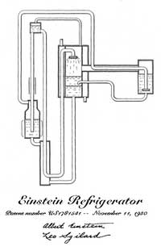
Albert Einstein
1926: Einstein and Leó Szilárd invented a refrigerator that runs on ammonia, butane, and water

Slide 14
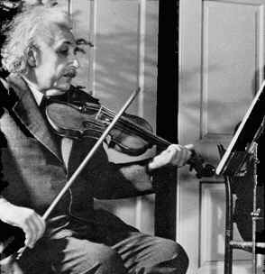
Albert Einstein
In 1933, at the age of 54, Einstein feels the heat of Nazi rule in Germany and escaped to Princeton University’s Institute for Advanced Study in America with Löwenthal
Became Professor of Theoretical Physics
Löwenthal dies in 1936
Became an American Citizen in 1940

Slide 15
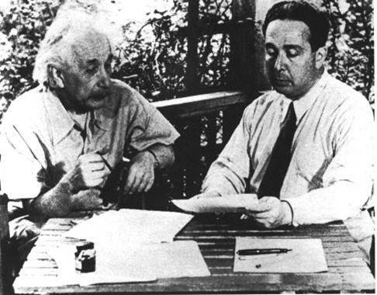
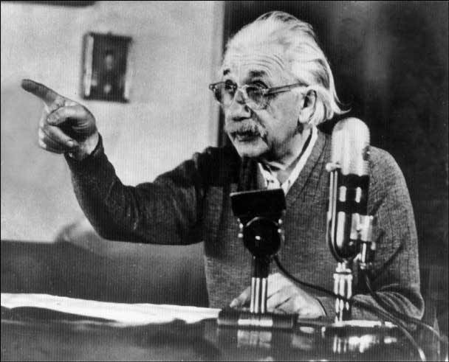
Albert Einstein
In 1939, Einstein wrote a letter to Franklin Roosevelt warning him that the Nazi Regime was in Nuclear Weapons research and urged the US to begin their own Nuclear research. Einstein worked with the US with his quantum theories
Retired from professorship in 1945
1948: Einstein helps to organize the founding of Brandeis University
In 1952, Einstein was offered the role of second president by the Israeli government. He declined, though he collaborated with Dr. Chaim Weizmann in establishing the Hebrew University of Jerusalem

Slide 16
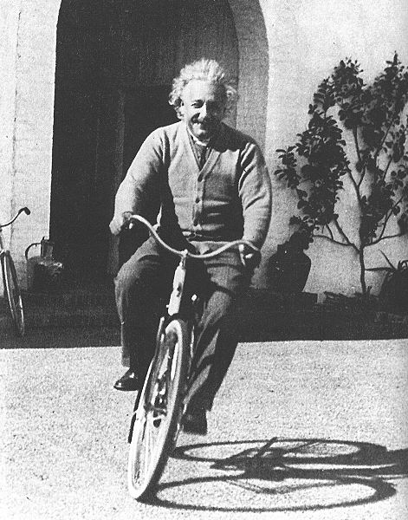
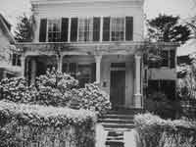
Albert Einstein
In 1953, Einstein released a revised unified field theory
Einstein died in his sleep in hospital in Princeton on April 18, 1955. A nurse heard his last words, but did not know the German language, so whatever he said, is lost.
He was cremated without ceremony the same day

Slide 17
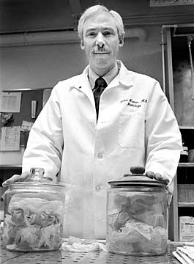
Albert Einstein
Dr. Thomas Stoltz Harvey, pathologist, kept Einstein’s brain
In 1999, a team at McMaster University – after analysis - revealed that his parietal operculum region was missing and his inferior parietal lobe was 15% wider than normal. No wonder mathematics came to him easily

Slide 18
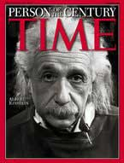
Albert Einstein
Stephen Hawkins picked up where Einstein left off on quantum physics, pushing the math further and further. Many of today’s fancy devices use Einstein’s own theories to work
Albert Einstein was voted Man Of The Century by Time Magazine
Many scientific objects carry Albert’s namesake: the photochemistry unit the einstein; chemical element 99, einsteinium; asteroid 2001, Einstein; the Albert Einstein College of Medicine of Yeshiva University; the Albert Einstein Peace Prize

Slide 19
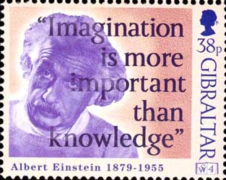
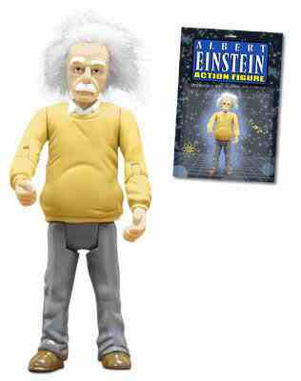
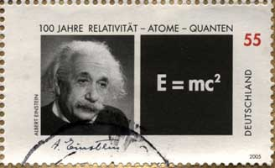
Albert Einstein
There are also Einstein products, stamps, statues, action figures and … !

Slide 20
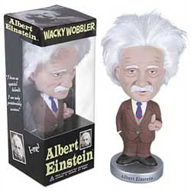
Albert Einstein
… bobbleheads!

Slide 21
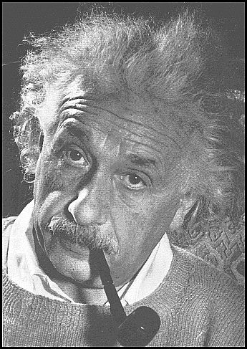
Albert Einstein
Reported by Brian Worrall
Any Questions?!?

